Slide 1

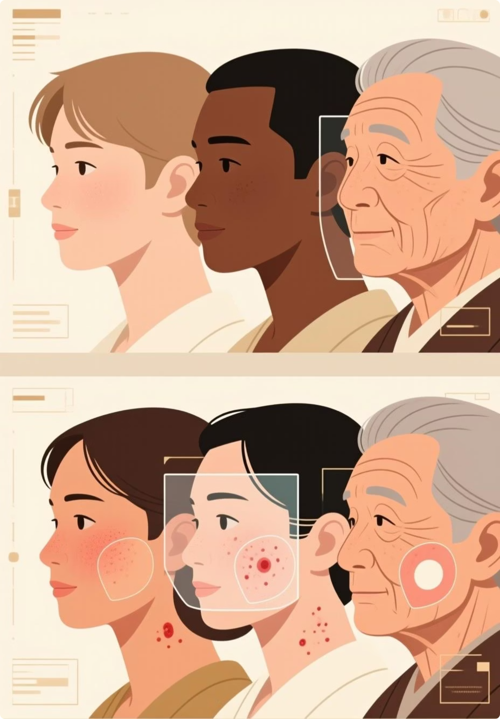
GlowAI: Project Review
GlowAI is an AI system for facial blemish analysis from selfies, using a two-stage pipeline: segmentation followed by classification into 4 skin-condition types.
What Changed from the Proposal
Reduced classes from 6 → 4
Updated segmentation and classification models
Refined synthetic data generation for balanced classes
Why GlowAI Is Needed
Real-world facial skin data is limited and biased
Poor representation of different skin tones, ages, lighting, and blemish types
Most datasets contain only clinical images, not selfies
GlowAI uses synthetic + real data to overcome these gaps
Project Contributions
End-to-end pipeline: detection, classification, localization, and skincare guidance
Region-level analysis for multiple blemishes per face
Balanced training across diverse skin types using synthetic data

Slide 2
Previous work
Title / Year
Task
Methods
Data
Results
Relation to GlowAI
Use of Artificial Intelligence in Dermatology (2020)
Review of AI applications for skin disease diagnosis
Machine Learning, Deep Learning, image analysis
Clinical skin image datasets
AI achieves high accuracy but is limited by data quality and real-world deployment
Supports GlowAI’s use of AI for facial skin analysis and blemish classification
Artificial Intelligence and Machine Learning in Dermatology (2023)
Review of AI for detection, classification, and severity assessment
Deep Learning, CNNs
Diverse dermatology image datasets
Accurate detection with challenges in bias and ethics
Highlights the need for balanced data, aligned with GlowAI’s synthetic + real data approach
AI Models for Benign Pigmented Facial Skin Lesions (2020)
Classification of pigmented facial lesions
Convolutional Neural Networks
Annotated facial skin images
Performance comparable to dermatologists
Demonstrates feasibility of facial skin lesion analysis, similar to GlowAI’s blemish detection

Slide 3
Dataset: Synthetic Data Generation
Synthetic Data Pipeline
ComfyUI inpainting (SD1.5 + IP-Adapter) → generates 512×512 faces with localized redness from (clean face + mask + defect reference).
Redness-v0 dataset
12 clean identities; structured folders: images/ (face+redness), masks/ (binary redness), clean/ (original).
Model + metrics
2-class U-Net (ResNet-34 encoder) for Background vs Redness; eval with mIoU + IoU(redness) on held-out val split.
Quality controls
prompt engineering + strong negatives (avoid makeup/blush), real defect refs via IP-Adapter, strict mask rules, and manual filtering to keep only realistic redness.

Slide 4
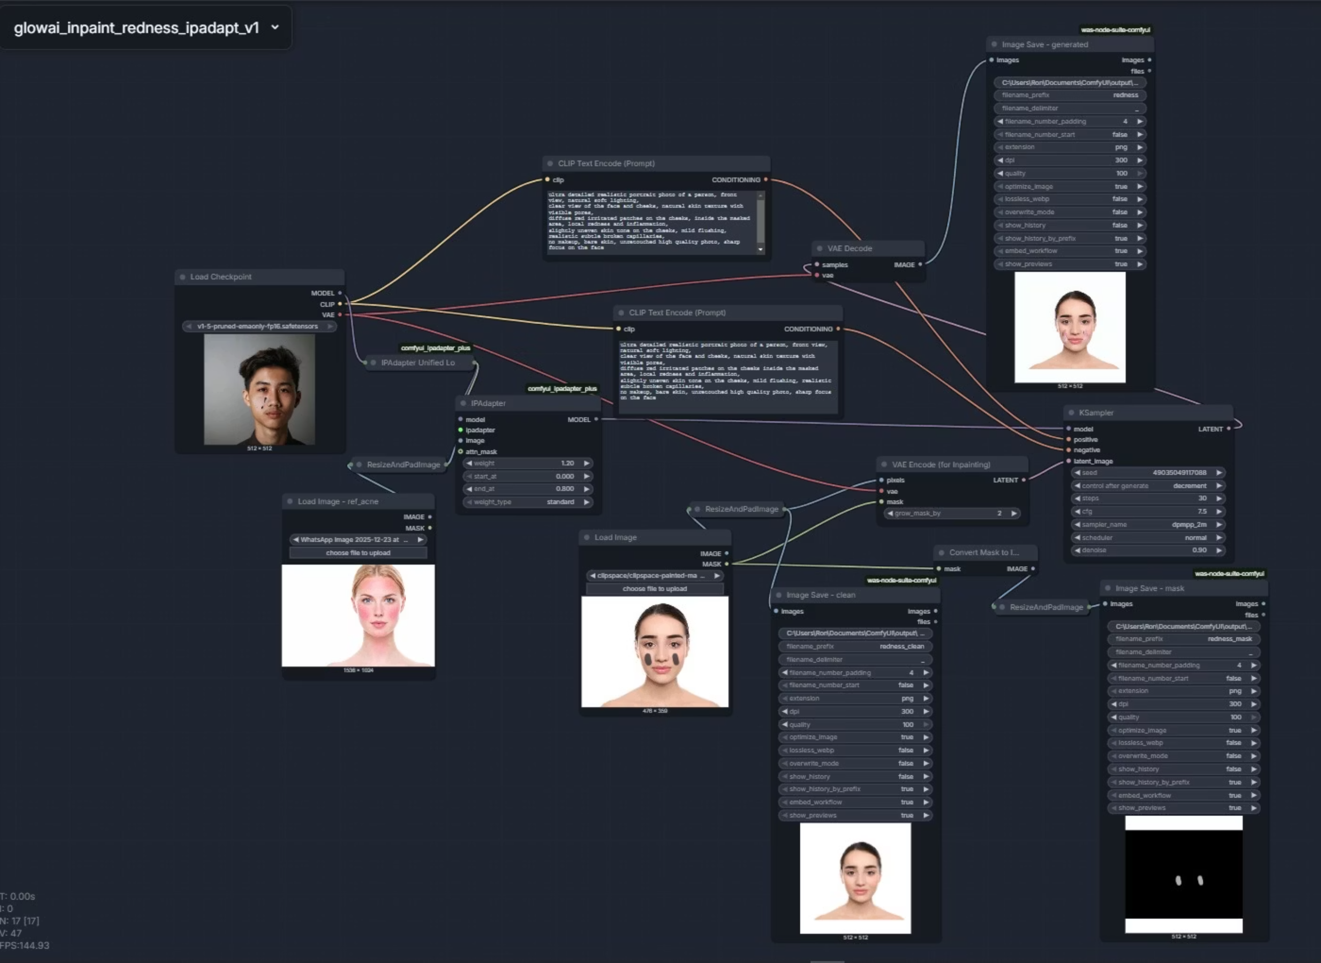

Slide 5
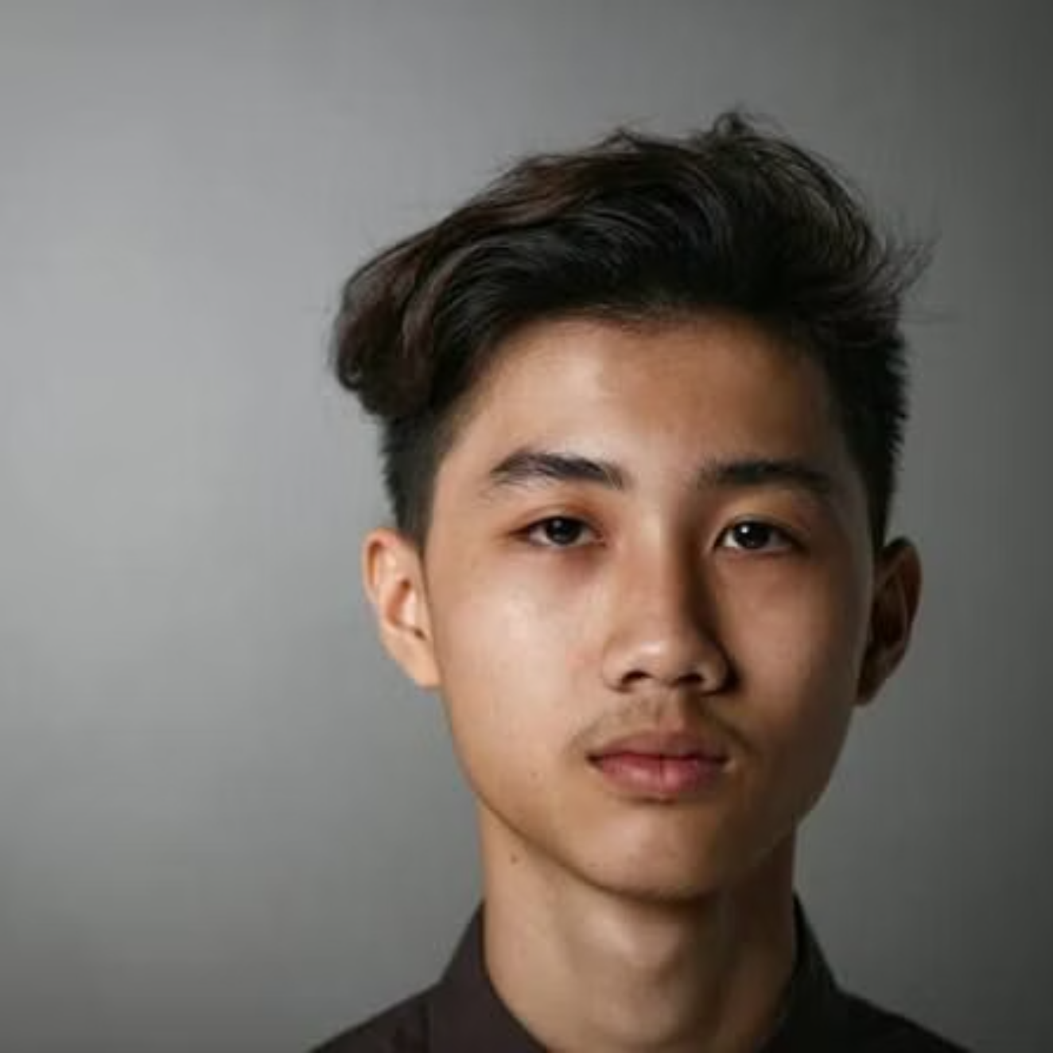
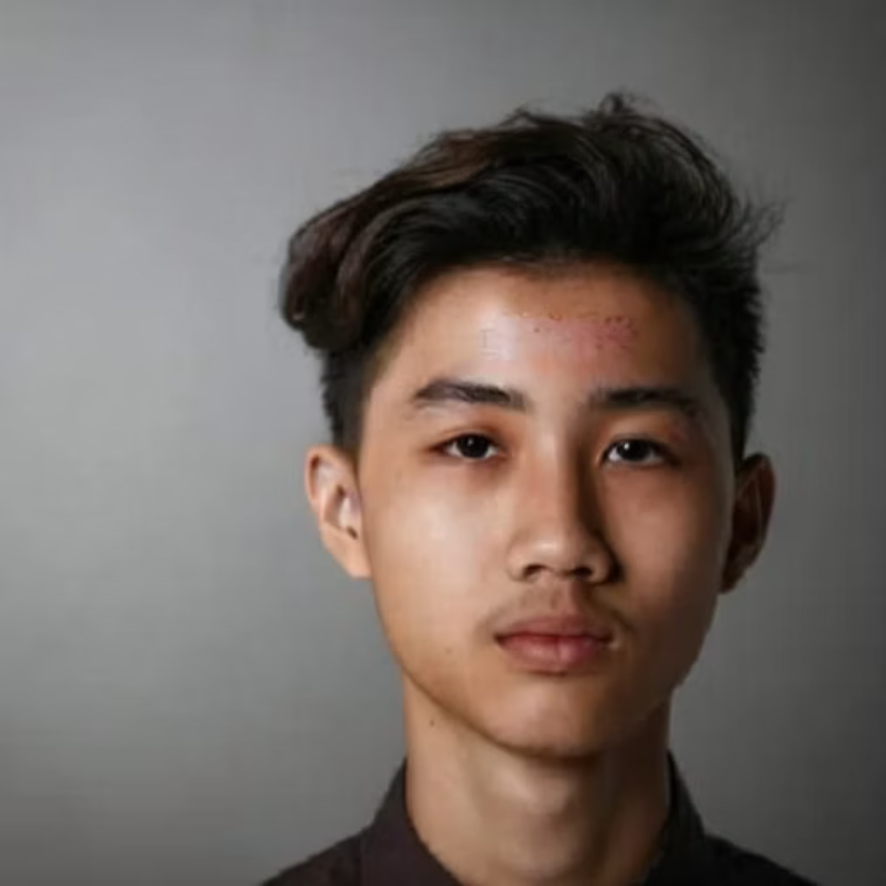

Slide 6

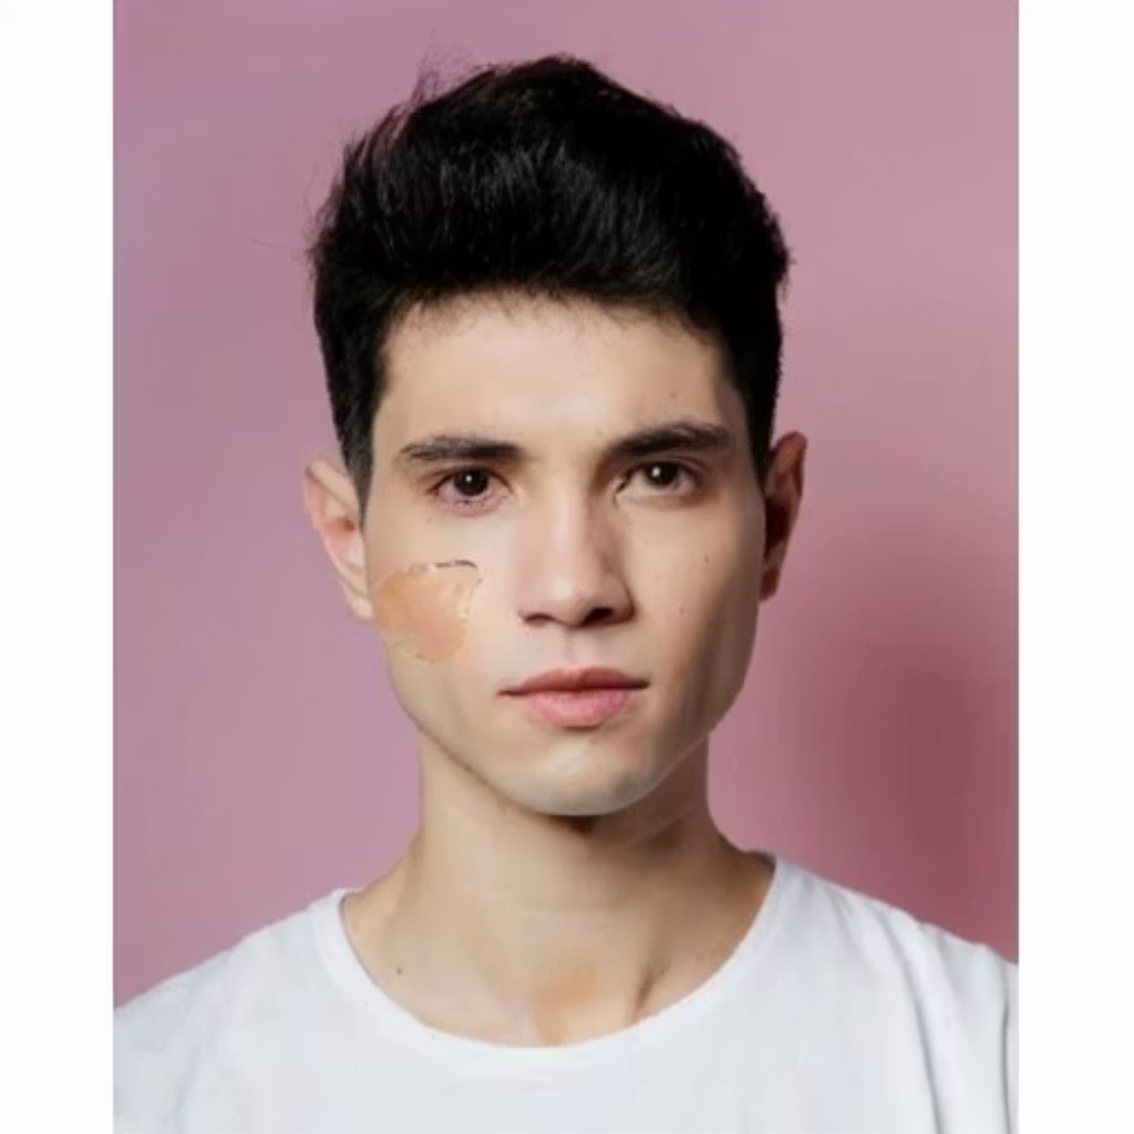

Slide 7
Baseline solution and results
Base Model
Training Data
Architecture: U-Net
Dataset: GlowAI-Synth v0 (synthetic facial images)
Encoder: ResNet-34 (ImageNet pretrained)
Generation: Stable Diffusion v1.5 (Inpainting, ComfyUI)
Input: RGB selfie image (3×H×W)
Labels: Pixel-accurate masks derived from inpainting masks
Output: Multi-class segmentation map (4×H×W)
Split: 80% Train / 20% Validation (synthetic only)
Activation: None (softmax applied only during loss / evaluation)
Training Setup
Evaluation Metrics
Loss: multi-class Cross-Entropy
Mean Intersection-over-Union (mIoU)
(we plan to experiment with a combination with Dice Loss in the next stage).
IoU per class
Optimizer: Adam (lr = 1e-4, batch size ≈ 8).
Train for a fixed number of epochs until convergence, saving the best checkpoint according to validation mIoU.

Slide 8
GlowAI Project Plan
Synthetic data generation – GlowAI-Synth v1
Turn the ComfyUI workflow into a semi-automatic pipeline and generate thousands of synthetic face images with skin defects (Acne, Redness, etc.) based on CelebA
Initial synthetic dataset GlowAI-Synth v1 + before/after examples
Baseline segmentation model training
Train a U-Net + ResNet-34 segmentation model on GlowAI-Synth v1 (80/20 train/val split, Cross-Entropy loss, Adam optimizer)
Baseline model GlowAI-Seg v1 + initial performance table (mIoU + per-class IoU)
Validation on real data & error analysis
Run the model on a small set of real selfie images with image-level labels, and identify failure patterns (especially Redness / Texture / Dryness)
Qualitative examples (input + predicted mask) + list of main failure modes
Model & data improvement – GlowAI-Seg v2
Expand the dataset (more diversity in skin tones, lighting, severity) and try model improvements (e.g., combined loss or an additional segmentation architecture)
Improved model GlowAI-Seg v2 + comparison vs. v1 (performance table / plots)
Image-level classification & user-facing view
Derive multi-label outputs from each segmentation mask and define basic logic for high-level user recommendations
Defect vector per image (Acne/Redness/…) + mock-up of an “app screen” (skin summary + general recommendations)

